Slide 1
Package Management
Ori Calvo, 2017 oric@trainologic.com http://trainologic.com

Slide 2
Objectives
© 2017 Ori Calvo
2
Motivation
Modules & packages
Dependencies
Package.json
Package managers
npm

Slide 3
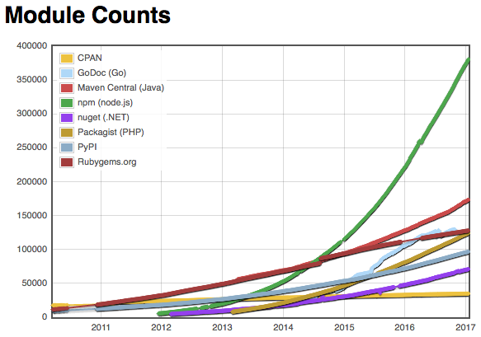
Motivation
© 2017 Ori Calvo
3
Users and modules are growing in immense rate
Need a reliable packaging mechanism
.
.

Slide 4
Modules and Packages
© 2017 Ori Calvo
4
Module – Is a code library
In Node, files & modules are in 1-to-1 relationship
e.g. foo.js loads module ./goo.js
Package - one or more modules packaged together
.
.

Slide 5
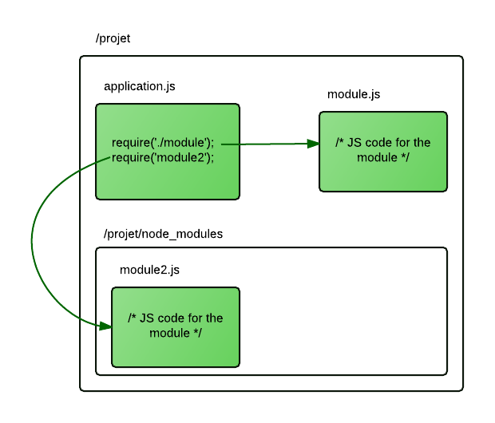
Modules and Packages
© 2017 Ori Calvo
5
Our app uses packages as building blocks

Slide 6
Dependencies
© 2017 Ori Calvo
6
Also are packages
Must be installed with our current package
May have different versions under different pckgs
app
├──foo
│ ├── hello ^0.7.2
│ └── world ^1.0.7
└── bar
├── hello ^1.0.8
└── goodbye ^3.4.0

Slide 7

Dependencies
© 2017 Ori Calvo
7
Which version should be installed?
Managing & Updating packages is no easy task.

Slide 8
Dev-Dependencies
© 2017 Ori Calvo
8
Case of scenario – publishing your app.
Some dependencies are installed for development
Typescript
Testing harnesses (jest)
No need for them in your production package
These qualify as dev-dependencies
npm install installs both dependency types
Use npm install --only=production for dependencies only

Slide 9
Peer-Dependencies
© 2017 Ori Calvo
9
Case scenarios – plugins, components.
May have dependencies their host also has
Plugin cannot know about them
Installing them both at the plugin and host may cause problems
Example – React component
React requires that only 1 instant runs
Without PD, 2 instances will run, causing errors
PD is manually written in package.json
PDs don’t install directly into local node_modules
npm will warn if host doesn’t have the dependency

Slide 10
package.json
© 2017 Ori Calvo
10
Found under every package’s root
Holds metadata relevant to it.
Used to identify it
States its version
Specifies its dependencies
{
“name” : “interview”,
“version” : “0.1.0”,
“dependencies” : {
…
},
“scripts” : {
“test” : “…..”
}, …
}
.
.

Slide 11
package.json properties
© 2017 Ori Calvo
11
Required – form the identifier for package
name
version
Most common
dependencies
main – package’s entry point e.g. “index.js”
scripts – start, test, build
dev-dependencies
description
Keywords – used for searches
repository - Specifies where the code lives

Slide 12
node_modules folders
© 2017 Ori Calvo
12
These contain the installed packages
May be local (our project) or global (node folder)
Locally Usually may be deleted and re-built/ installed
Packages install usually from remote repos
No need to include them when sharing our code
Package.json ensures package coherency
Should be .gitignore’d

Slide 13


Package managers
© 2017 Ori Calvo
13
Are a bunch of CLI commands to handle pckgs
install/uninstall/update/publish.
Many more
Make it easy to resolve dependencies
package.json is their source for most actions

Slide 14
npm - intro
© 2017 Ori Calvo
14
The de-facto standard package manager
Installs with node
Current version 5.3
Major performance improvement over ver 4.x.x
Update by typing: npm install npm@latest –g
Some npm commands have scope
Local, destined to the current project
Global, using –g flag, typically destined to node folder

Slide 15
npm – versioning rules
© 2017 Ori Calvo
15
Packages are installed by versions
Written in package.json dependencies
Most packages use Semver - Semantic Versioning
major.minor.patch
Packages update rapidly
npm uses version ranges to accommodate that
Installs and updates the latest allowed in the range
“dependencies” : {
“express” : “4.14.0”
},

Slide 16
npm – versioning rules
© 2017 Ori Calvo
16
Caret (^)
upto, but not including, the next major number
“immutable” : “^3.8.1” - version 3.9.6 may be installed, but not 4.0.0
Tilde (~)
upto, but not including, the next minor number
“redux” : “~3.5.2” - version 3.5.7 may be installed, but not 3.6.0
<, >, <=, >=
“lodash” : “<3.5.2” – must be less than 3.5.2

Slide 17
npm commands
© 2017 Ori Calvo
17
init - Creates a package in the current project
install -
Install all dependencies in package.json
Install and update package.json
Staring from v 5 --save is default
Install globally
uninstall
update
All installed packages to latest version
Install missing ones
$ npm init
$ npm install
$ npm install react --save
$ npm install jest -g

Slide 18
npm commands
© 2017 Ori Calvo
18
update
All installed packages to latest version
Install missing ones
$ npm update
$ npm update react
$ npm update jest -g
ls ( alias list )
List all installed locally
List all ‘react’ packages
$ npm ls
$ npm ls react
$ npm list jest -g

Slide 19
npm commands
© 2017 Ori Calvo
19
start
Runs a command specified in ‘scripts’
If not exists runs ‘node server.js’
repo
Opens ‘react’ repo in github
home
Opens ‘react’ home page
dedupe
attempts to simplify local dependency tree
$ npm repo react
$ npm home react

Slide 20
npm commands
© 2017 Ori Calvo
20
start
Runs a command specified in ‘scripts’
If not exists runs ‘node server.js’
repo
Opens ‘react’ repo in github
home
Opens ‘react’ home page
$ npm repo react
$ npm home react

Slide 21
npm commands
© 2017 Ori Calvo
21
dedupe
attempts to simplify local dependency tree
The dependency tree
will resolve to
app
├──foo <-- depends on who@1.0.x
│ └──who@1.0.3
└──goo<-- depends on who@~1.0.9
└──who@1.0.10
app
├──foo
├──goo
└──who@1.0.10

Slide 22
npm – lock files
© 2017 Ori Calvo
22
Version ranges may cause installation anomalies
Newer dependency versions from last install might exist
Different npm versions might resolve slighty differently
One user might have a different tree from another
Need a way to settle this
npm emits package-lock.json while installing
Starting from v5
holds an exact and reproducible node_modules tree
When exists, future installations will differ
Will base on this file
Will not recalculate a tree from package.json
Include it in git commits!

Slide 23
npm – lock files
© 2017 Ori Calvo
23
npm uses another lock file type : npm-shrinkwrap.json
Same functionality and structure as package-lock
npm doesn’t publish package-lock file with package
It does too with npm-shrinkwrap.json
To create one type npm shrinkwrap
If package-lock exists – will change the name
Otherwise will create one.
npm-shrinkwrap.json overrides package-lock

Slide 24
npm – configuring
© 2017 Ori Calvo
24
Npm is configurable via several sources
commandline
environment variables
.npmrc files
Following settings will be written in a .npmrc file
Found in [user path]/ .npmrc
npm init props may be set here
npm set init.author.name – change default author name
npm set init.version – change default version
npm set init.license – change defaut license type

Slide 25
npm – configuring
npm config
proxy http://proxy.company.com:8080
© 2017 Ori Calvo
24
If need to install from another repo:
npm set registry https://registry.npmjs.org
prefix – location where globally installed items reside
production – set to “true” to run in “production” mode
If need to run in production mode
npm set production=true
May also type: npm install --production
If need to run npm under a proxy (default null)
npm proxy http://proxy.company.com:8080

Slide 26
yarn
© 2017 Ori Calvo
25
npm is not the only player in the packaging game
yarn is the newest kid in town
In public use from end of 2016
Developed by Facebook
To answer performance problems using npm at the time
Utilizes lock files
Installs packages much faster than npm 4
Has no independent repository
Uses npm repository as its package intalltion source
Was considered by many a better alternative to npm

Slide 27
yarn
© 2017 Ori Calvo
26
Version 5 changed all that
Much better installation times rival those of yarn
Also utilizes lock files
Better flagging: --save not necessary, as it’s the default
yarn seems to be the “cool newer thing Much better
npm seems to be more than enough

Slide 28
Package Resolution at runtime
© 2017 Ori Calvo
27
Suppose we have
A module in node_modules called foobar.js, containing
A file called ‘app.js’:
function foo() {
return 'bar';
}
module.exports.foo = foo;
const {foo, bar} = require('foobar');
console.log (foo());

Slide 29
Package Resolution at runtime
© 2017 Ori Calvo
28
When we run node app.js
Node loads app.js, parses it and evaluates it.
It finds the absolute path of foo.js.
loads the foo.js into memory.
wraps foo.js giving it its private scope.
evaluates foo.js
assigns the return value in ‘exports’ in first code
to the ‘require’ in 2nd code
it caches the result for reuse
‘

